Slide 1

WELCOME
COHORT 5
7th Sept – 3rd Dec 2026
Suite 6-6-7, Level 6, Menara MAA

Slide 2
HTTP and REST API Fundamentals
HTTP Methods and Their Purpose:
GET: Retrieve data (read-only operations)
POST: Create new resources
PUT: Update entire resources
PATCH: Partial updates
DELETE: Remove resources
Notes:
1st:
HTTP is the protocol used for web communication.
REST APIs usually use JSON and standard HTTP methods.
Question:
If you want to update a user’s email, which method would you pick?

Slide 3
HTTP and REST API Fundamentals
HTTP Status Codes:
200-299: Success responses
300-399: Redirection messages
400-499: Client error responses
500-599: Server error responses

Slide 4
HTTP and REST API Fundamentals
REST API Principles:
Stateless communication
Resource-based URLs
Standard HTTP methods
JSON data format
Consistent response structure
Notes:
REST APIs are built around resources.
Each resource usually has a URL, and each HTTP method acts on that resource.
Good REST APIs are stateless – the server doesn’t remember previous requests.
They return consistent JSON so the client knows how to parse responses.

Slide 5
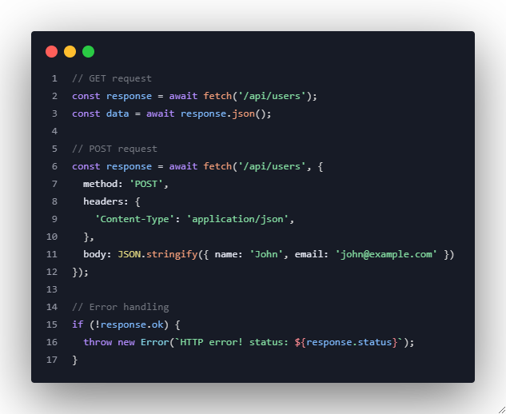
Modern Data Fetching with Fetch API
Basic Fetch Syntax:

Slide 6
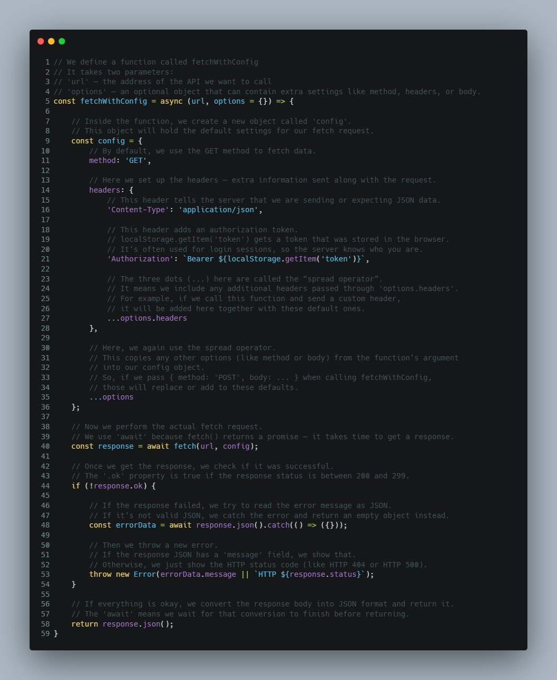
Modern Data Fetching with Fetch API
Advanced Fetch Configuration:

Slide 7
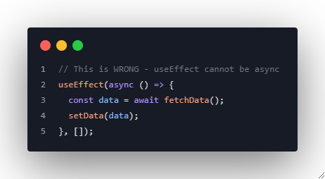
Async/Await Patterns in useEffect
❌ Common Mistake - Making useEffect Async:
Notes:
A frequent mistake is to mark the useEffect callback as async directly.
This is not allowed because useEffect expects either nothing or a cleanup function, not a promise.

Slide 8
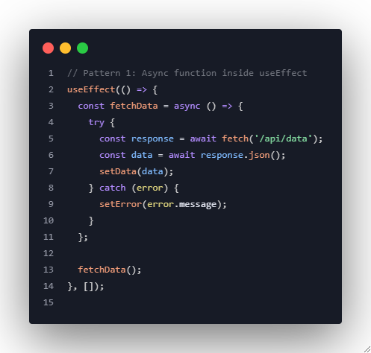
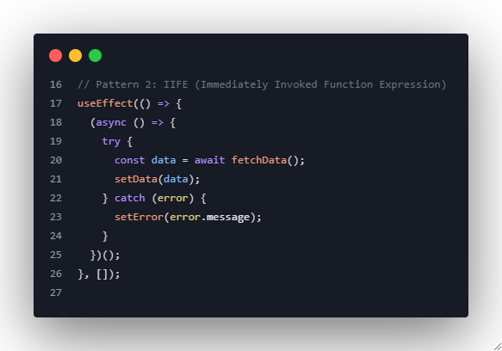
Async/Await Patterns in useEffect
✅ Correct Patterns:
Notes:
useEffect must not directly return a promise. The effect callback should either return nothing or a cleanup function – it should not be async.
The try/catch ensures network and parsing errors are caught and handled instead of being unobserved.
The IIFE allows await syntax directly in the effect body without declaring a named inner function.
The flow (await -> set state -> catch) is still easy to read.

Slide 9
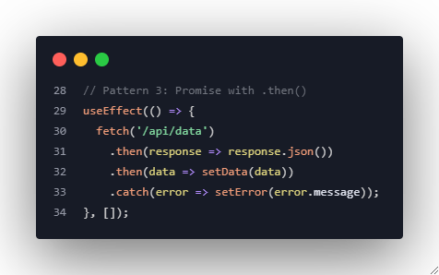
Async/Await Patterns in useEffect
✅ Correct Patterns:

Slide 10
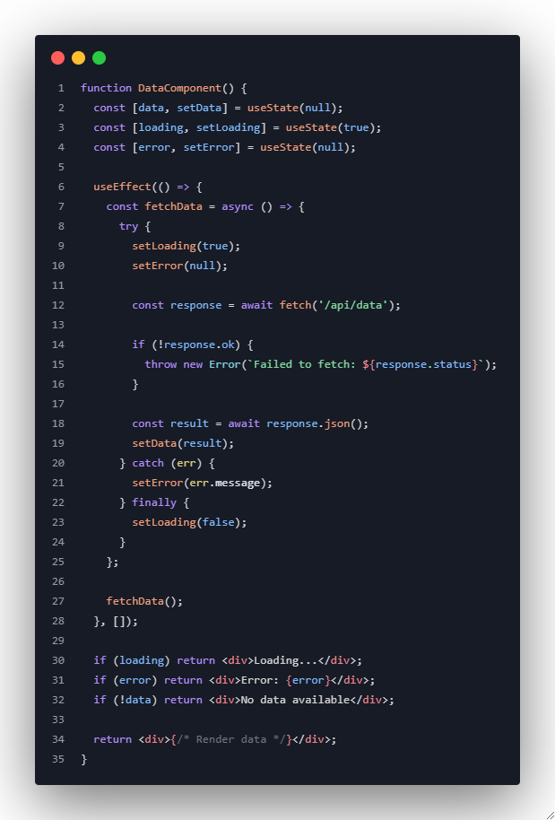
Error Handling and Loading States

Slide 11
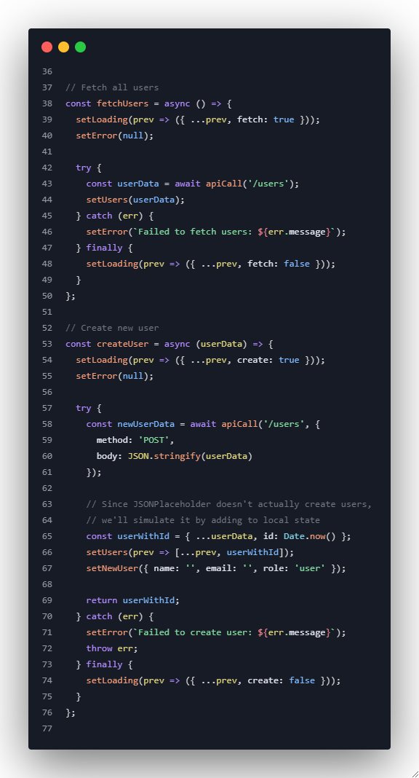
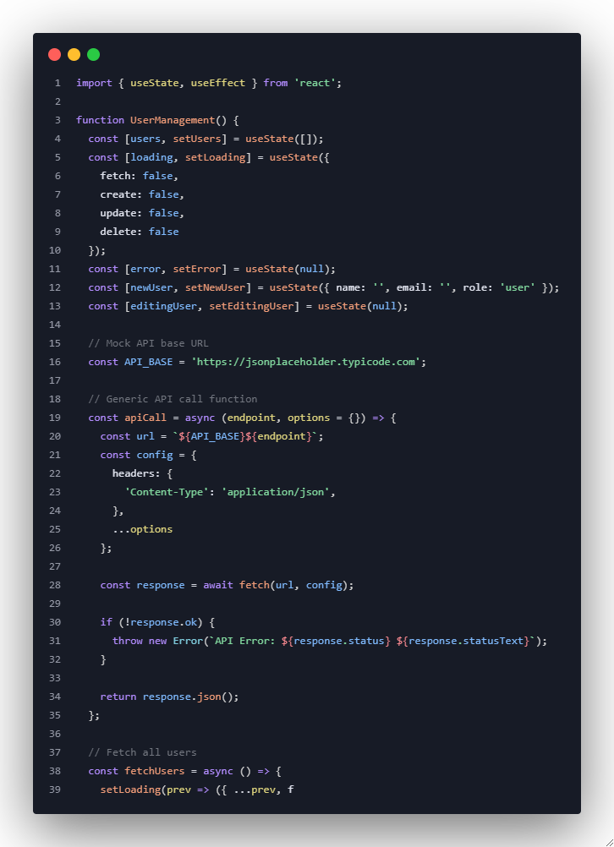
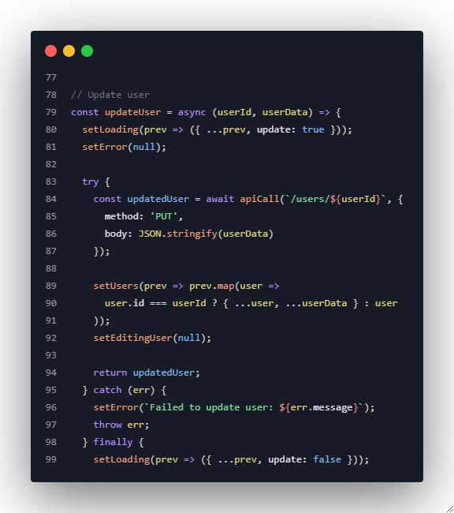
Example 1: User Management System
Notes:
import { useState, useEffect } from "react";
function UserManagement() {
const [users, setUsers] = useState([]);
const [loading, setLoading] = useState({
fetch: false,
create: false,
update: false,
delete: false
});
const [error, setError] = useState(null);
const [newUser, setNewUser] = useState({ name: '', email: '', role: 'user' });
const [editingUser, setEditingUser] = useState(null);
const API_BASE = 'https://jsonplaceholder.typicode.com';
const apiCall = async (endpoint, options = {}) => {
const url = `${API_BASE}${endpoint}`;
const config = {
headers: {
'Content-Type': 'application/json',
},
...options
};
const response = await fetch(url, config);
if (!response.ok) {
throw new Error(`API Error: ${response.status} ${response.statusText}`);
}
return response.json();
};
const fetchUsers = async () => {
setLoading(prev => ({ ...prev, fetch: true }));
setError(null);
try {
const userData = await apiCall('/users');
setUsers(userData);
} catch (err) {
setError(`Failed to fetch users: ${err.message}`);
} finally {
setLoading(prev => ({ ...prev, fetch: false }));
}
};
const createUser = async (userData) => {
setLoading(prev => ({ ...prev, create: true }));
setError(null);
try {
const newUserData = await apiCall('/users', {
method: 'POST',
body: JSON.stringify(userData)
});
const userWithId = { ...userData, id: Date.now() };
setUsers(prev => [...prev, userWithId]);
setNewUser({ name: '', email: '', role: 'user' });
return userWithId;
} catch (err) {
setError(`Failed to create user: ${err.message}`);
throw err;
} finally {
setLoading(prev => ({ ...prev, create: false }));
}
};
const updateUser = async (userId, userData) => {
setLoading(prev => ({ ...prev, update: true }));
setError(null);
try {
const updatedUser = await apiCall(`/users/${userId}`, {
method: 'PUT',
body: JSON.stringify(userData)
});
setUsers(prev => prev.map(user =>
user.id === userId ? { ...user, ...userData } : user
));
setEditingUser(null);
return updatedUser;
} catch (err) {
setError(`Failed to update user: ${err.message}`);
throw err;
} finally {
setLoading(prev => ({ ...prev, update: false }));
}
};
const deleteUser = async (user) => {
setLoading(prev => ({ ...prev, delete: true }));
setError(null);
try {
await apiCall(`/users/${user.id}`, {
method: 'DELETE'
});
setUsers(prev => prev.filter(u => u.id !== user.id));
} catch (err) {
setError(`Failed to delete user: ${err.message}`);
} finally {
setLoading(prev => ({ ...prev, delete: false }));
}
};
useEffect(() => {
fetchUsers();
}, []);
const handleCreateSubmit = async (e) => {
e.preventDefault();
if (!newUser.name || !newUser.email) {
setError('Name and email are required');
return;
}
try {
await createUser(newUser);
} catch (err) {
// Already handled
}
};
const handleUpdateSubmit = async (e) => {
e.preventDefault();
if (!editingUser.name || !editingUser.email) {
setError('Name and email are required');
return;
}
try {
await updateUser(editingUser.id, editingUser);
} catch (err) {
// Already handled
}
};
return (
<div className="user-management">
<h2>User Management System</h2>
{error && (
<div className="error-banner">
<p>❌ {error}</p>
<button onClick={() => setError(null)}>x</button>
</div>
)}
<div className="create-user-section">
<h3>Add New User</h3>
<form onSubmit={handleCreateSubmit}>
<input
type="text"
placeholder="Name"
value={newUser.name}
onChange={(e) => setNewUser(prev => ({ ...prev, name: e.target.value }))}
required
/>
<input
type="email"
placeholder="Email"
value={newUser.email}
onChange={(e) => setNewUser(prev => ({ ...prev, email: e.target.value }))}
required
/>
<select
value={newUser.role}
onChange={(e) => setNewUser(prev => ({ ...prev, role: e.target.value }))}
>
<option value="user">User</option>
<option value="admin">Admin</option>
<option value="moderator">Moderator</option>
</select>
<button type="submit" disabled={loading.create}>
{loading.create ? 'Creating...' : 'Create User'}
</button>
</form>
</div>
<div className="users-section">
<div className="section-header">
<h3>Users ({users.length})</h3>
<button onClick={fetchUsers} disabled={loading.fetch}>
{loading.fetch ? 'Refreshing...' : 'Refresh'}
</button>
</div>
{loading.fetch && users.length === 0 ? (
<div className="loading">Loading users...</div>
) : (
<div className="users-grid">
{users.map(user => (
<div key={user.id} className="user-card">
{editingUser?.id === user.id ? (
<form onSubmit={handleUpdateSubmit}>
<input
type="text"
value={editingUser.name}
onChange={(e) => setEditingUser(prev => ({ ...prev, name: e.target.value }))}
required
/>
<input
type="email"
value={editingUser.email}
onChange={(e) => setEditingUser(prev => ({ ...prev, email: e.target.value }))}
required
/>
<div className="edit-actions">
<button type="submit" disabled={loading.update}>
{loading.update ? 'Saving...' : 'Save'}
</button>
<button type="button" onClick={() => setEditingUser(null)}>
Cancel
</button>
</div>
</form>
) : (
<>
<h4>{user.name}</h4>
<p>{user.email}</p>
<p>Role: {user.role || 'user'}</p>
<div className="user-actions">
<button onClick={() => setEditingUser(user)}>Edit</button>
<button
onClick={() => deleteUser(user)}
disabled={loading.delete}
className="delete-btn"
>
Delete
</button>
</div>
</>
)}
</div>
))}
</div>
)}
{users.length === 0 && !loading.fetch && (
<div className="empty-state">
<p>No users found. Create your first user above!</p>
</div>
)}
</div>
</div>
);
}
export default UserManagement;

Slide 12
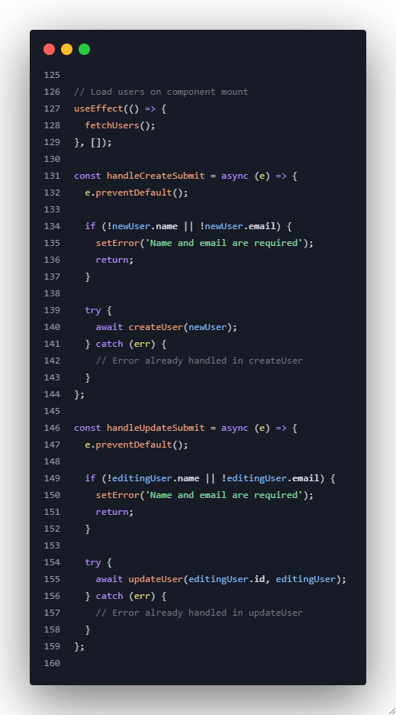
Example 1: User Management System
The return jsx code is in the presenter’s notes.
Notes:
return (
<div className="user-management">
<h2>User Management System</h2>
{error && (
<div className="error-banner">
<p>❌ {error}</p>
<button onClick={() => setError(null)}>×</button>
</div>
)}
{/* Create User Form */}
<div className="create-user-section">
<h3>Add New User</h3>
<form onSubmit={handleCreateSubmit}>
<input
type="text"
placeholder="Name"
value={newUser.name}
onChange={(e) => setNewUser(prev => ({ ...prev, name: e.target.value }))}
required
/>
<input
type="email"
placeholder="Email"
value={newUser.email}
onChange={(e) => setNewUser(prev => ({ ...prev, email: e.target.value }))}
required
/>
<select
value={newUser.role}
onChange={(e) => setNewUser(prev => ({ ...prev, role: e.target.value }))}
>
<option value="user">User</option>
<option value="admin">Admin</option>
<option value="moderator">Moderator</option>
</select>
<button type="submit" disabled={loading.create}>
{loading.create ? 'Creating...' : 'Create User'}
</button>
</form>
</div>
{/* Users List */}
<div className="users-section">
<div className="section-header">
<h3>Users ({users.length})</h3>
<button onClick={fetchUsers} disabled={loading.fetch}>
{loading.fetch ? 'Refreshing...' : 'Refresh'}
</button>
</div>
{loading.fetch && users.length === 0 ? (
<div className="loading">Loading users...</div>
) : (
<div className="users-grid">
{users.map(user => (
<div key={user.id} className="user-card">
{editingUser?.id === user.id ? (
<form onSubmit={handleUpdateSubmit}>
<input
type="text"
value={editingUser.name}
onChange={(e) => setEditingUser(prev => ({ ...prev, name: e.target.value }))}
required
/>
<input
type="email"
value={editingUser.email}
onChange={(e) => setEditingUser(prev => ({ ...prev, email: e.target.value }))}
required
/>
<div className="edit-actions">
<button type="submit" disabled={loading.update}>
{loading.update ? 'Saving...' : 'Save'}
</button>
<button type="button" onClick={() => setEditingUser(null)}>
Cancel
</button>
</div>
</form>
) : (
<>
<h4>{user.name}</h4>
<p>{user.email}</p>
<p>Role: {user.role || 'user'}</p>
<div className="user-actions">
<button onClick={() => setEditingUser(user)}>
Edit
</button>
<button
onClick={() => deleteUser(user.id)}
disabled={loading.delete}
className="delete-btn"
>
Delete
</button>
</div>
</>
)}
</div>
))}
</div>
)}
{users.length === 0 && !loading.fetch && (
<div className="empty-state">
<p>No users found. Create your first user above!</p>
</div>
)}
</div>
</div>
);
}

Slide 13
Exercise 1: News Aggregator
Task: Build a news aggregator with multiple sources
Requirements:
Fetch from multiple news APIs
Handle different response formats
Implement caching to reduce API calls
Add search and filtering capabilities
Handle rate limiting and errors gracefully
(API Lists)

Slide 14
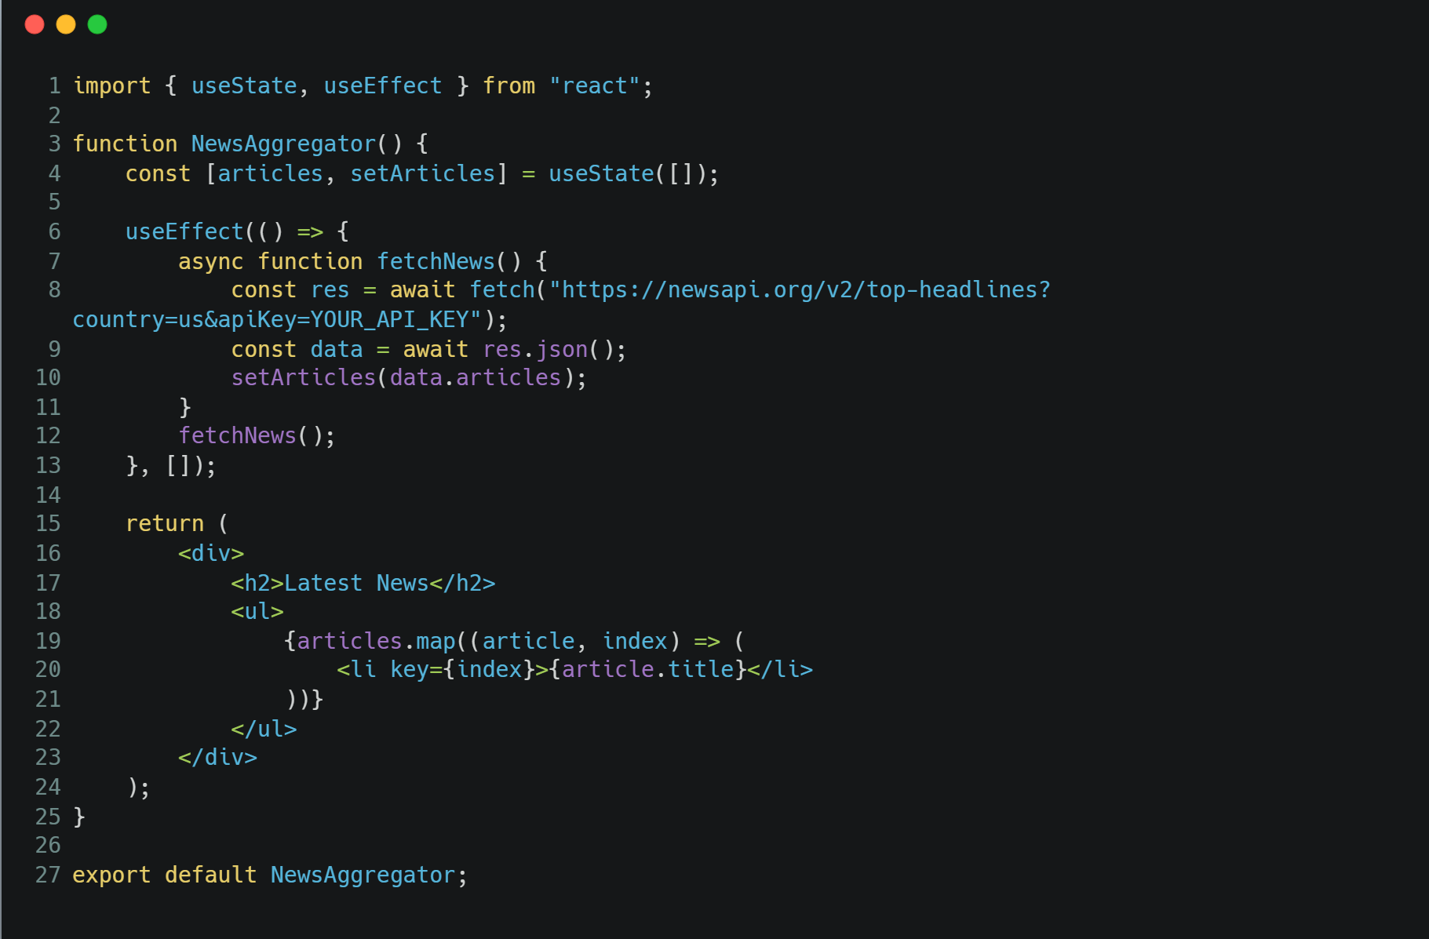

Slide 15
Exercise 2: Weather Forecast App
Task: Create a comprehensive weather application
Requirements:
Current weather and 7-day forecast
Geolocation integration
Multiple city tracking
Weather alerts and notifications
Offline caching with service worker simulation
(API Lists)

Slide 16
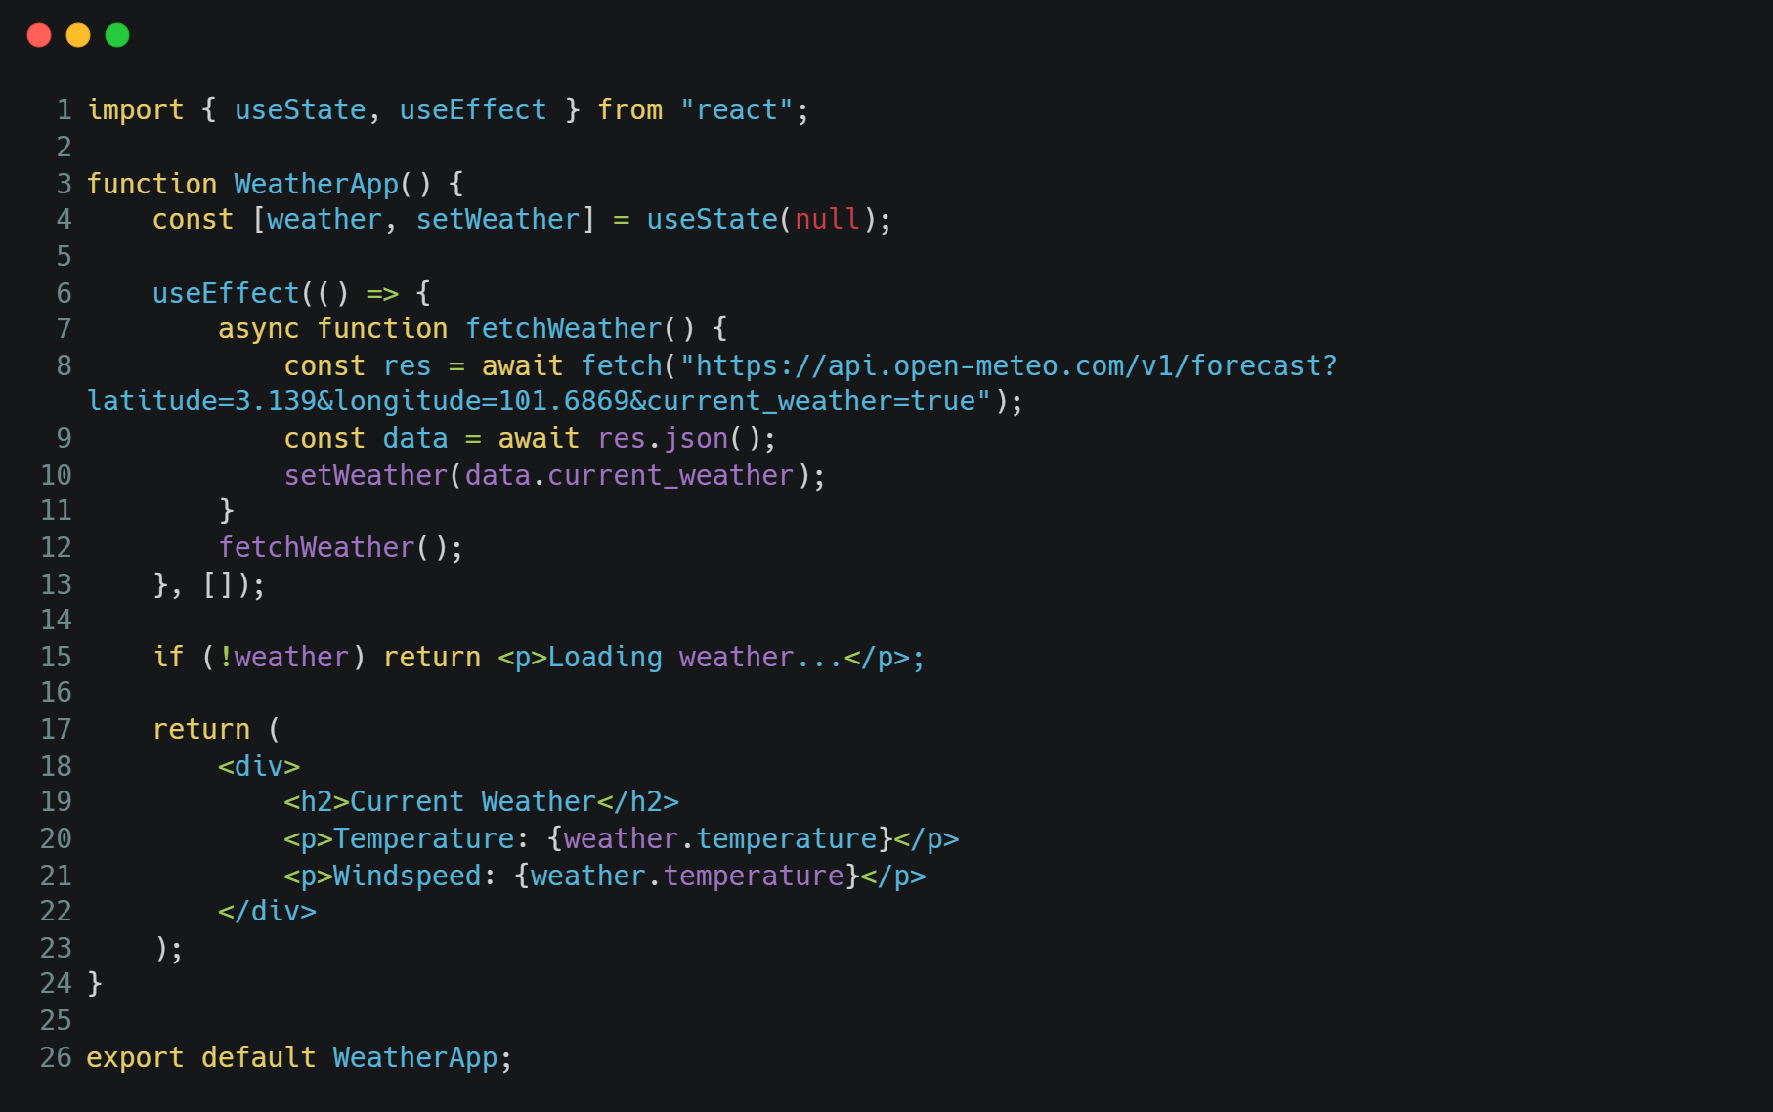

Slide 17
Key Learning Outcomes
By the end of this session, you will be able to:
✅ Master modern data fetching patterns with fetch API
✅ Implement proper async/await patterns in React
✅ Handle loading states, errors, and edge cases effectively
✅ Build robust API integration with retry logic and caching
✅ Implement real-time data updates and WebSocket connections
✅ Create advanced search functionality with debouncing
✅ Handle complex data flows and state management
✅ Implement proper cleanup and memory management

